Slide 1

CASE STUDY -1 Machine Learning Lab
Name: Aakash kumar group : B
Uid:18bcs6007 submitted to: Mrs . Shifali mam

Slide 2


DATA VISUALIZATION
And analysis

Slide 3
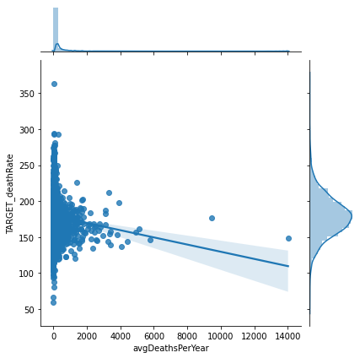
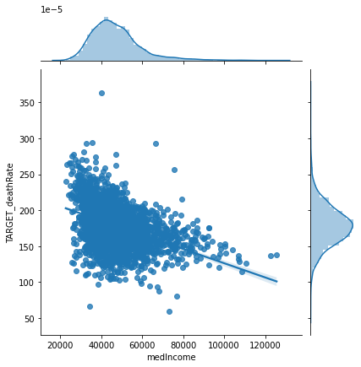
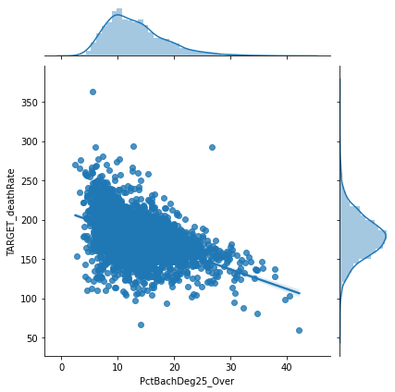
SCATTER PLOTS against the TARGET_deathRate
avgDeathsPerYear
medIncome
PctBatchDeg_25

Slide 4
Now let’s have a look on few of the OUTLIERS

Slide 5
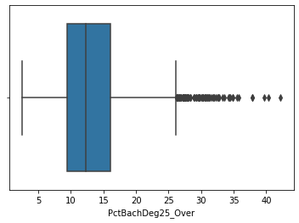
PctBachDeg25_Over
Clearly the outliers are visible

Slide 6
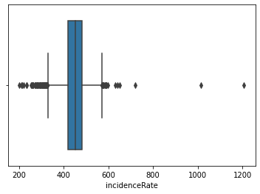
incidenceRate
Clearly the outliers are visible

Slide 7
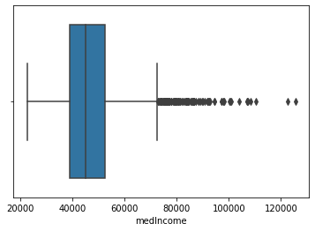
medincome
Clearly the outliers are visible

Slide 8
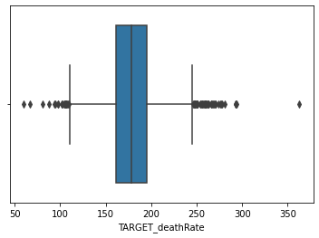
TARGET_deathRate
Clearly the outliers are visible

Slide 9
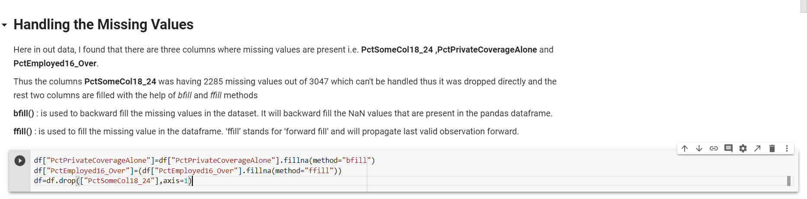
Handle Missing Values

Slide 10
Kernal Density Estimation (KDE) PLOTS along with normalised plots i.e. NORMALISATION

Slide 11
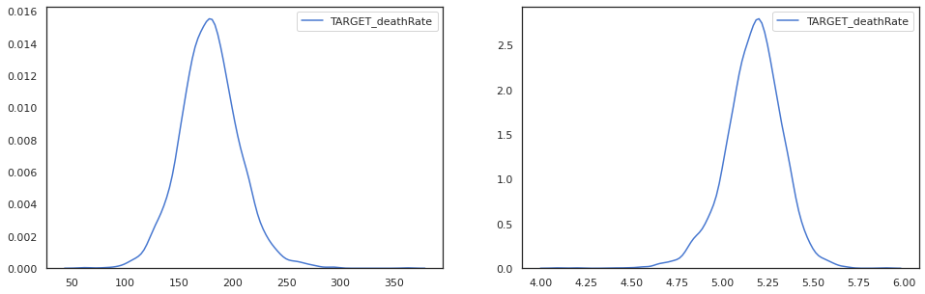
TARGET_deathRate

Slide 12
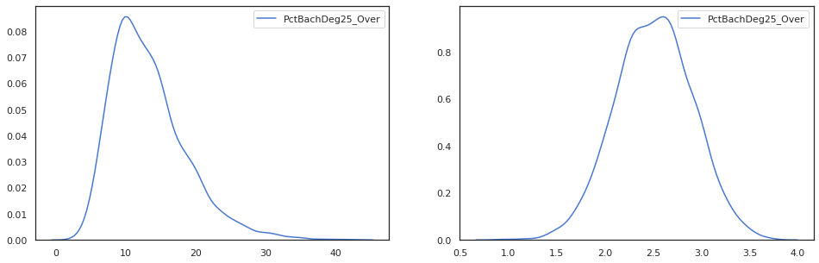
PctBachDeg25_Over

Slide 13
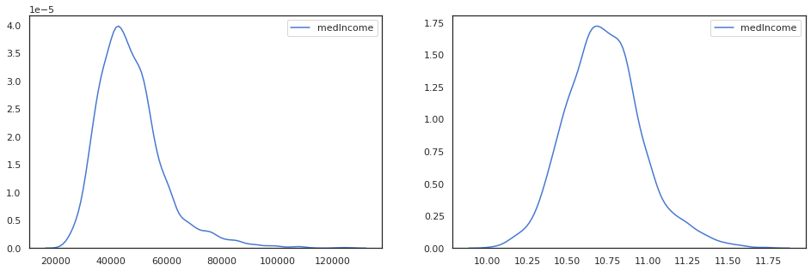
medIncome

Slide 14
HEAT MAP

Slide 15
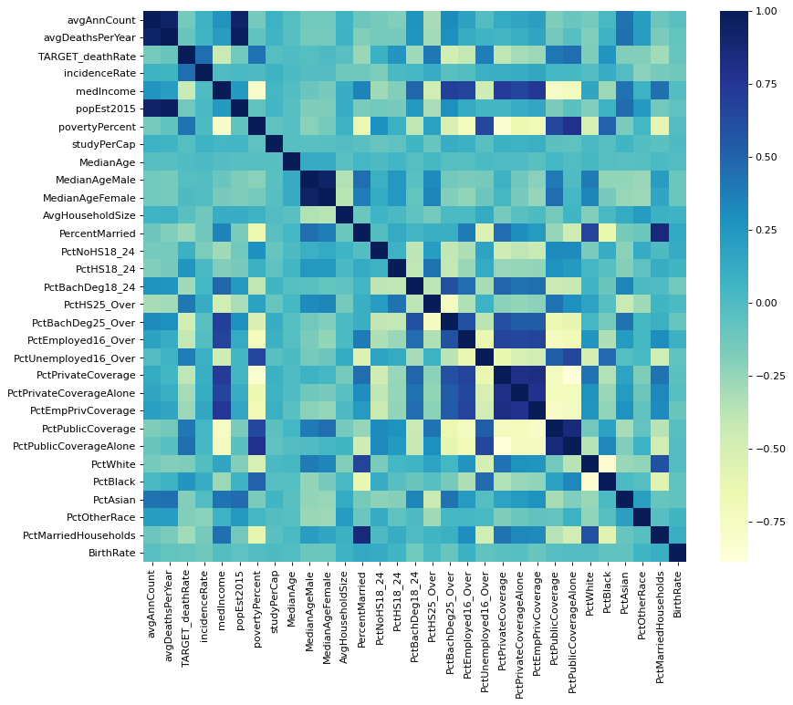
A heatmap is a graphical representation of data that uses a system of color-coding to represent different values.
Here we find that very few columns have correlation above 0.4 :
PctEmployed16_Over 0.403575 PctPublicCoverage 0.404572 PctHS25_Over 0.404589 medIncome 0.428615 povertyPercent 0.429389 PctPublicCoverageAlone 0.449358 incidenceRate 0.449432 PctBachDeg25_Over 0.485477 TARGET_deathRate 1.000000

Slide 16
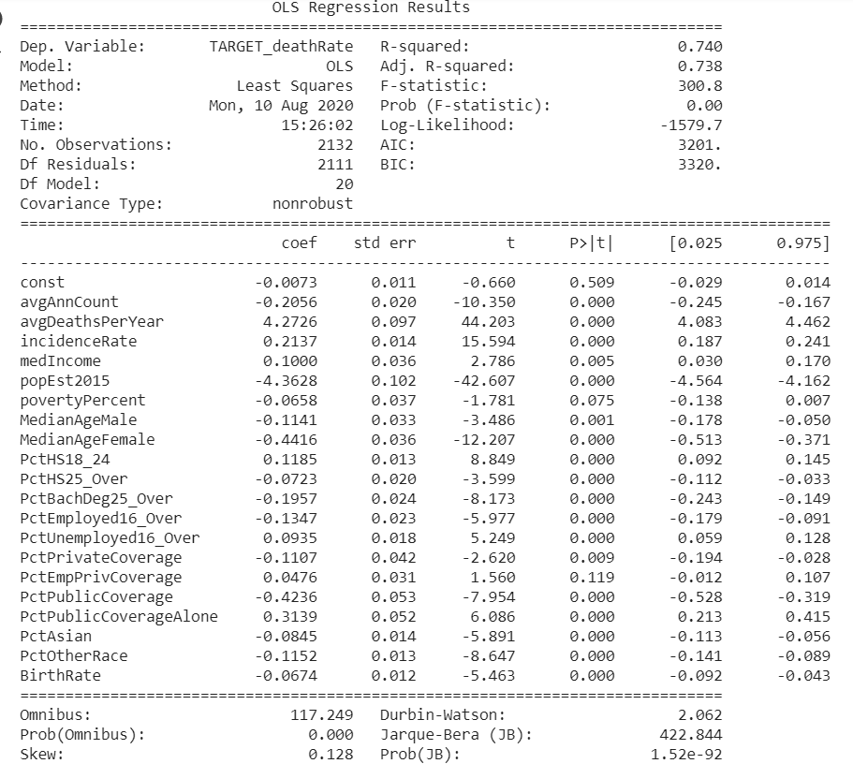
OLS REGRESSION RESULT
R-squared value : 0.74
Adj. R-squared value : 0.738
Skew : 0.128

Slide 17
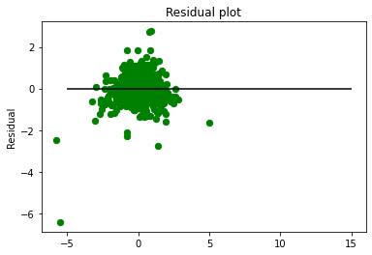
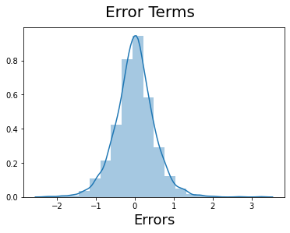
Error Analysis

Slide 18
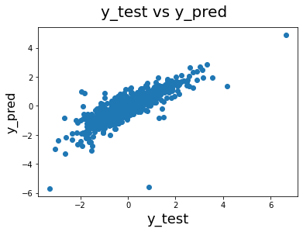
PREDICTION VS ACTUAL VALUES

Slide 19
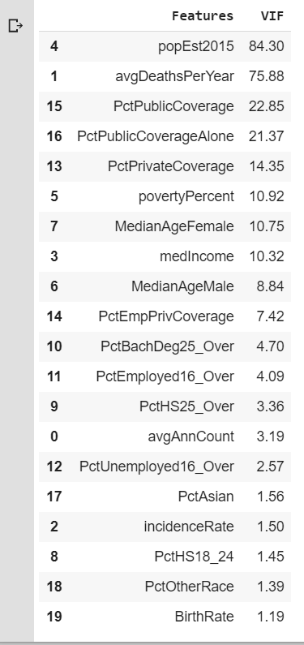
OPTIMISATION
VIF TABLE:
Here we observe VIF values of some columns are very high thus removing those columns

Slide 20
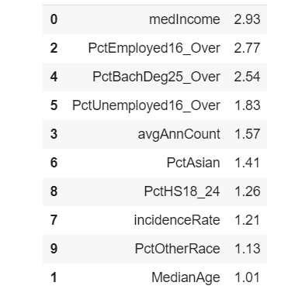
OPTIMISATION
VIF TABLE:
FINAL Reduced Table with all the VIF values less than 3

Slide 21
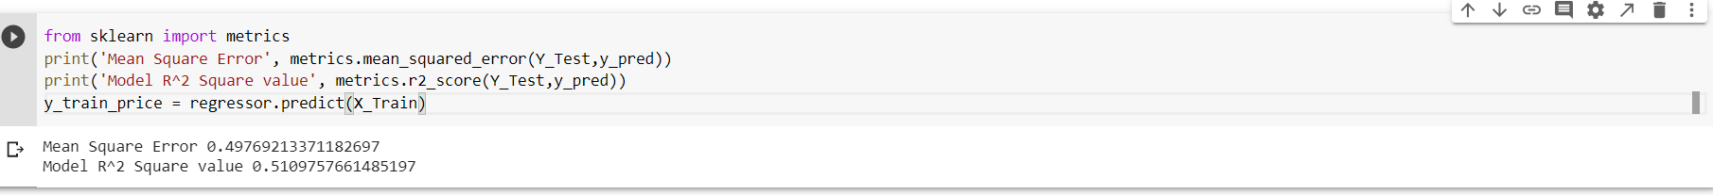
Mean Squared Error and R2 value after optimisation

